Slide 1

Maven Market Report

Slide 2
Table of contents
01
02
03
Overview
Analysis
Conclusion

Slide 3

Overview
01

Slide 4
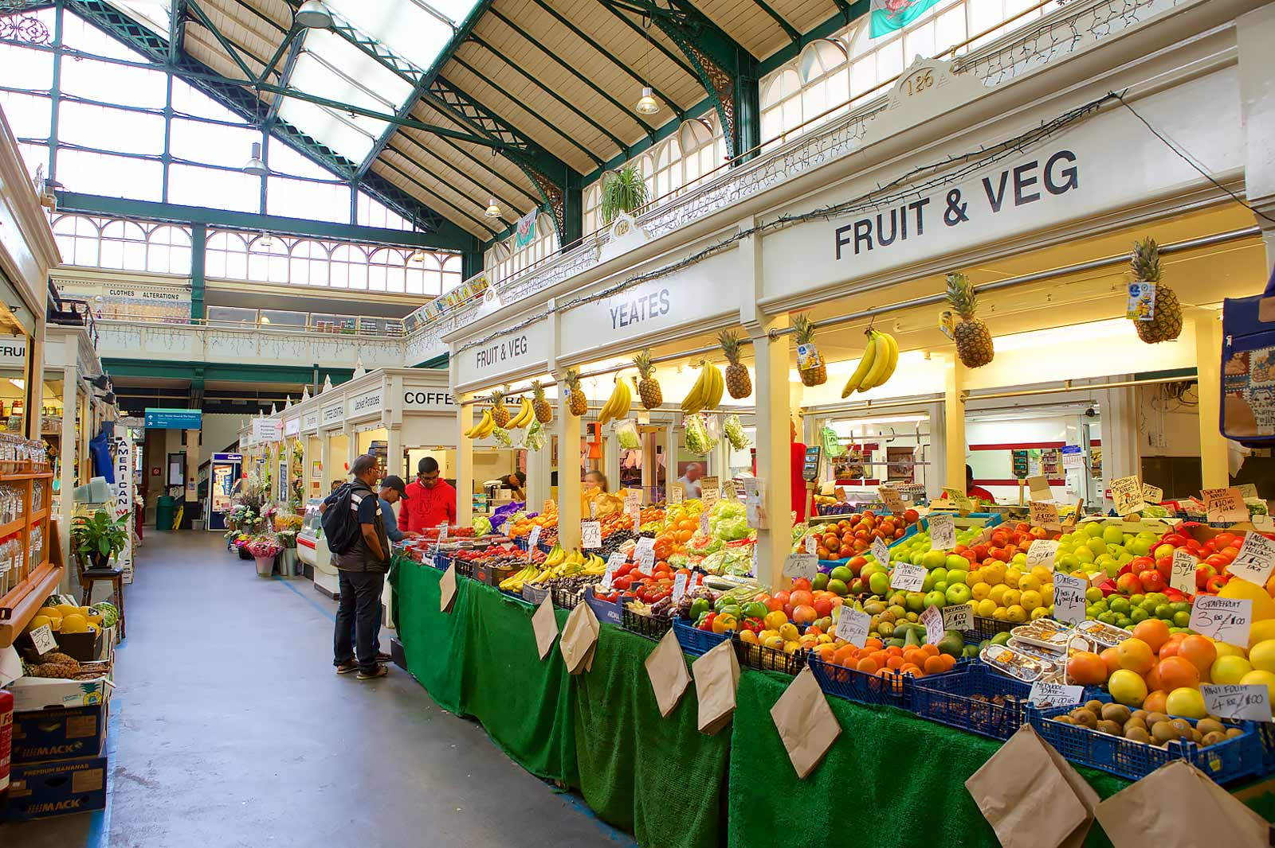

Maven Market
Context:
Maven Market is a worldwide supermarket chain, operating hundreds of stores throughout the United States, Mexico, and Canada.
The chain comprises various store types, including Deluxe Supermarkets, Gourmet Supermarkets,,… which offer a diverse range of products such as food, beverages, dairy, snacks, and more.

Slide 5
Maven Market
Business goal:
Analyzing:
Business overview
Customer demographics & behaviors
Giving 2 – 3 suggestions.

Slide 6

Analysis
02

Slide 7
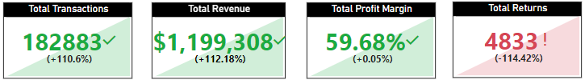
Business Overview
Business Activities
Based on the statistics, in 2018, the business activity has increased rapidly with a doubling of both Total Transactions and Revenue (with a growth rate of +110.6% and 112.18%, respectively). However, it is worth noting that the Total Returns have also doubled compared to last year.

Slide 8
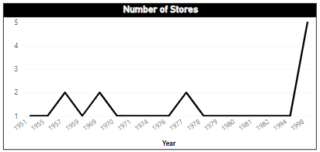
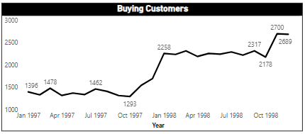
Business Overview
Business Activities
This can be explained by:
The opening of an increasing number of Stores in 1998.
A rise in the number of Buying Customers.

Slide 9
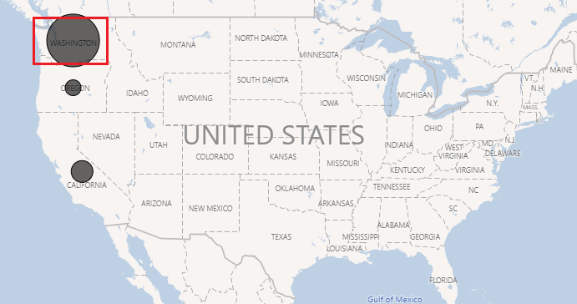
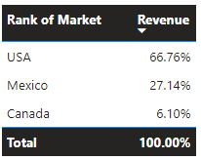
Business Overview
Market Ranking
In terms of Market Ranking, the USA has contributed the highest Revenue, accounting for 66.76% of the total. In closer examination, the state of Washington is the most significant contributor to our sales. On the other hand, Mexico has contributed 27.14%, while Canada's contribution was only 6.10%.

Slide 10
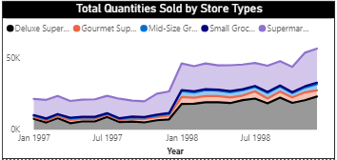
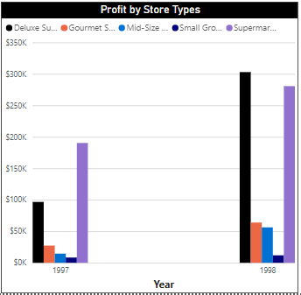
Business Overview
Store type
There have been significant improvements in both the Quantities Sold and Profits for each store type.
The Deluxe Supermarket stands out with the most significant increase, experiencing a 300% growth in profits, while the Gourmet and Mid-size Supermarkets also saw impressive growth rates of approximately 100%. In contrast, the Small Grocery store type remained unchanged growth with very little profits compared to the other store types.

Slide 11
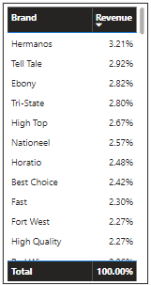
Business Overview
Brand
Overall, the revenues of the brands are relatively similar with no standout performers. Among them, the top spot belongs to Hermanos (3.21%), followed by Tell Tale (2.92%) at second place, and Ebony (2.82%) at third place On the other hand, Symphony, Toretti, and King represent the bottom three brands, contributing to nearly 0.1% of the total revenue.

Slide 12
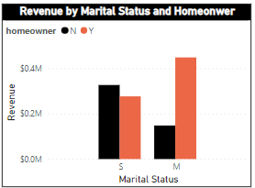
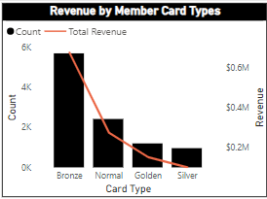
Customer Demographics
Marital Status and Homeowner
For Marital Status and Homeonwer, the largest revenue contribution of approximately $0.45 million came from the group of customers who were married and owned a house, which was twice the contribution of the group who were married but did not own a house, with a revenue of approximately $0.15 million.
Meanwhile, the group of customers who are single and either own or do not own a house made substantial contributions.
About the distribution of Card Types among customers, the most common type was Bronze (5.7K), followed by Normal (2.4K), Golden (1.2K) and Silver (960). As a result, the company should find some ways to encourage customers to upgrade their card type and make more purchases.
Card Type

Slide 13
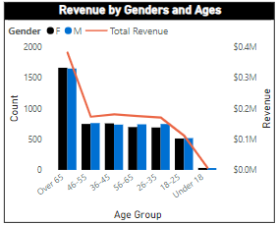
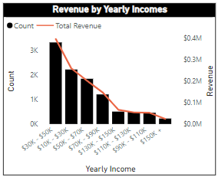
Customer Demographics
Age Group
For the Age group, our customers are primarily adults between the ages of 26 and 55. This age group represents the biggest growth opportunity for the company. However, it is interesting that the company also has a significant customer base among those over 55 years of age. This demographic may be more interested in products such as health and wellness, home goods, and travel,…
For the Annual Incomes, a significant portion of the customers fall within the low-middle income range, from $10k - $90k, spending a moderate amount of money on our company’s products. Meanwhile, there are only a few customers with higher incomes who make purchases and contribute minimally to our revenue.
Annual Income

Slide 14
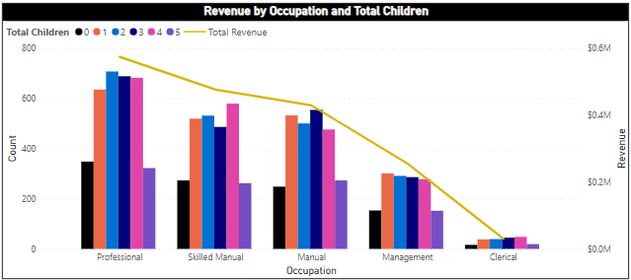
Customer Demographics
Occupation and Total Children
About Occupation and Total Children, it is noteworthy that customers with children (1-4 children) contributed more revenue than those without children. Professional job holders comprised the largest count and revenue contributors compared to a small number of Clerical job holders. Meanwhile, the group of Skilled Manual and Manual job holders contributed the second highest amount, which was slightly more than that of Management job holders.

Slide 15
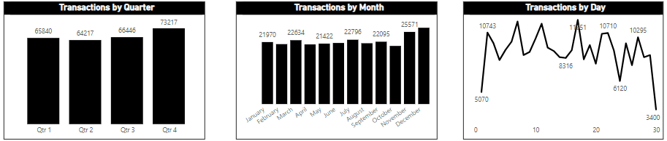
Customer Behaviors
We can observe that a significant surge in shopping activities occurs during Quarter 4, particularly in November and December. Some factors could contribute to this trend, such as: Thanksgiving Day, Christmas Celebration, Year-End Sales and Promotions,…
In term of Transactions by Day, customers have a tendency to buy less at the end and beginning of the month , which may be due to budget constraints after paying bills. However, between days 10 and 20, they buy more frequently, possibly because of receiving paychecks and feeling financially stable. We can leverage this information to optimize marketing strategies and capitalize on peak buying periods.

Slide 16
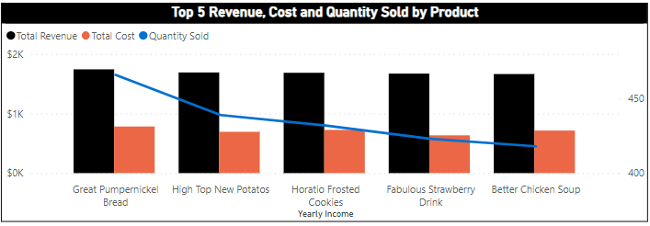
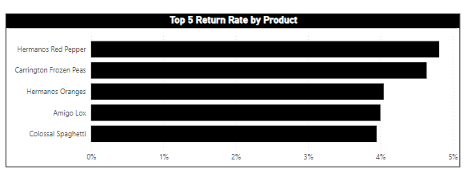
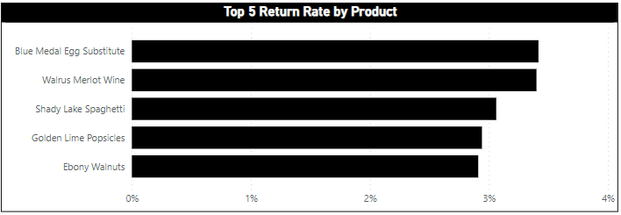
Product
Top Revenue, Cost and Quantity Sold
In the top 5 products by Revenue, Cost, and Quantity Sold, we can see that most of these products belong to the food and beverage category. The top product is Great Pumpernickel Bread, followed by High Top New Potatoes, Horatio Frosted Cookies, Fabulous Strawberry Drink, and Better Chicken Soup.
For the top 5 products with the highest Return Rates, we notice a positive trend in 1998, with Blue Medal Egg Substitute and Wairus Meriott Wine having the highest return rates, just a bit above 3%.
Top Return Rate
1997
1998

Slide 17
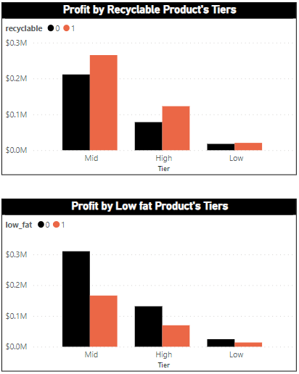
Product
Profit by Recyclable and Low Fat Product’s Tiers
From the chart, we can see profits for recyclable products consistently outperform those for non-recyclable ones, with the highest profits found in the mid-tier category, followed by the high-tier and low-tier categories.
About low-fat products, non-low-fat items generally yield higher profits than their low-fat ones. And the tier ranking for this criterion is the same with recyclable products, with the top tier being mid-tier, followed by high-tier and low-tier.

Slide 18
Conclusion
Suggestions:
The Return Rate in 2018 doubled compared to that in 2017. However, upon closer examination, we can see that the return rates for the top 5 products have actually decreased. Hence, our focus should shift away from specific products and towards a more holistic approach to address the overall return rate issue. As a result, it is imperative that we identify the root causes of this problem, such as system errors, inappropriate policies or any significant events that may be contributing to it.
Our customers are primarily the Age Group 55 and above, who tend to purchase products related to health and wellness, home goods, and travel. These preferences reflect their focus on well-being, comfort, and leisure. Meeting these needs is crucial for ensuring their satisfaction. To effectively address these preferences, we could implement targeted marketing campaigns that highlight the health benefits of our products, emphasize the comfort and durability of our home goods, and showcase travel experiences tailored for older adults.

Slide 19
Conclusion
Suggestions:
To maximize sales, we should focus on targeted promotions during the holiday season, especially in November and December. Additionally, offering discounts at the end of the month and emphasizing marketing efforts between the 10th and 20th can help boost sales. Some of the actions such as implementing customer loyalty programs and maintaining adequate stock levels of popular products in health and wellness, home goods, and travel categories during Quarter 4, offering middle-month special discount will also enhance overall profitability.
Our customers mainly fall within the low-middle income range, with the Bronze membership tier being the most popular and revenue-generating option. To optimize our business strategy, we should focus on enhancing sales and expanding product offerings specifically to this specific customer group. Some of the recommendations are: Introducing exclusive benefits or discounts for Bronze members, developing targeted marketing campaigns that satisfy the needs of this group, enhancing the Bronze membership loyalty program to reward frequent purchasers and encourage repeat business,…

Slide 20

Thank you!

